Slide 1
Digital Image Processing
Assignment 3

Slide 2
Question 1
In this question I first took an image and added different noises as asked in question
After that I used different filters to DE noise the image
Here the filters used are Low pass filter, Inverse filter, weiner filter, Bilateral filter

Slide 3
Adding different types of noises

Slide 4
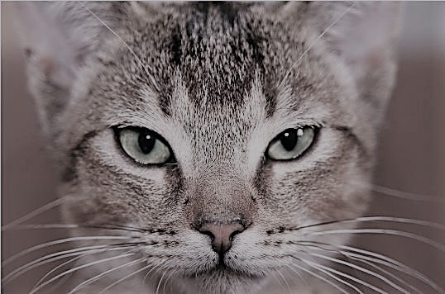
Original Image

Slide 5
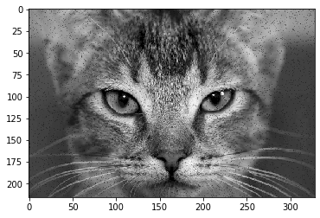
Salt and pepper noise

Slide 6
Question 1

Slide 7
Question 1
In this question I first took an image and added different noises as asked in question
After that I used different filters to DE noise the image
Here the filters used are Low pass filter, Inverse filter, weiner filter, Bilateral filter

Slide 8
Question 1
In this question I first took an image and added different noises as asked in question
After that I used different filters to DE noise the image
Here the filters used are Low pass filter, Inverse filter, weiner filter, Bilateral filter

Slide 9
Question 1
In this question I first took an image and added different noises as asked in question
After that I used different filters to DE noise the image
Here the filters used are Low pass filter, Inverse filter, weiner filter, Bilateral filter

Slide 10
Question 1
In this question I first took an image and added different noises as asked in question
After that I used different filters to DE noise the image
Here the filters used are Low pass filter, Inverse filter, weiner filter, Bilateral filter

Slide 11
Question 1
In this question I first took an image and added different noises as asked in question
After that I used different filters to DE noise the image
Here the filters used are Low pass filter, Inverse filter, weiner filter, Bilateral filter

Slide 12
Question 1
In this question I first took an image and added different noises as asked in question
After that I used different filters to DE noise the image
Here the filters used are Low pass filter, Inverse filter, weiner filter, Bilateral filter

